Slide 1
Instagram user analytics

Slide 2
contents
Loyal Users, Inactive Users
User with most Likes
Famous Tags & Number of Account creations- Day-wise
Average post per person
Bot detection

Slide 3
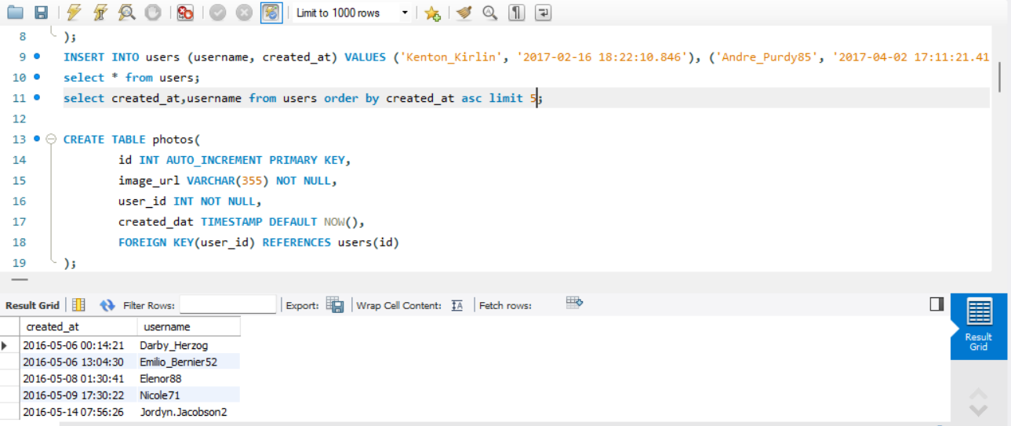
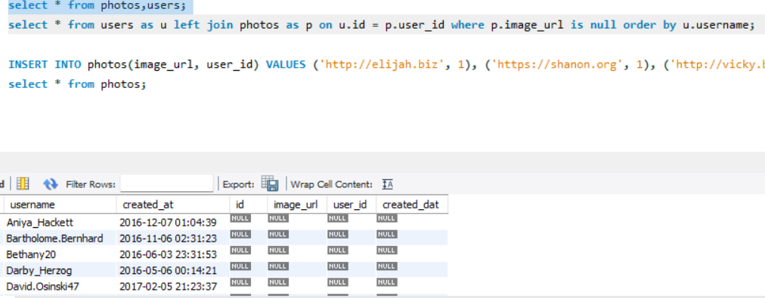
most loyal users: 1 Dary Herzog 2 Emilo 3 Elenor 4 Nicole 5 Jordyn users who have not posted: > There are around 26 users who have not posted a photo.

Slide 4
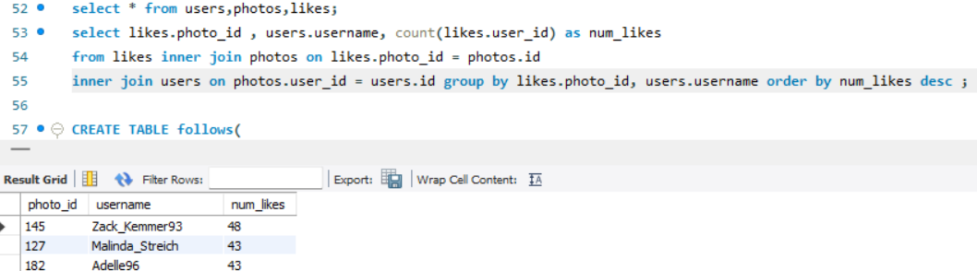
Most likes:
Zack_Kemmer93 has the most number of likes (48) followed by Malinda and Adelle with 43 likes.

Slide 5
Tags:
Smile is the most used tag(59 times).
Most accounts creation:
The following table depicts the count of accounts created on specific weekdays:
Weekday | Count of accounts created:
Thursday | 16
Sunday | 16
Friday | 15
Tuesday | 14
Monday | 14
Wednesday | 13
Saturday | 12

Slide 6
Average post per person: 2.57 post(s)/person
Average Photo Posts
Total Instagram Users
Total Photos Posted
100
257

Slide 7
Bot detection:
Aniya_Hackett | 257
Bethany20 | 257
Duane60 | 257
Jaclyn81 | 257
Janelle.Nikolaus81 | 257
Julien_Schmidt | 257
Leslie67 | 257
Maxwell.Halvorson | 257
Mckenna17 | 257
Mike.Auer39 | 257
Nia_Haag | 257
Ollie_Ledner37 | 257
Rocio33 | 257
The above users are potential bot accounts since all these users have liked all the posts in the application which is humanly not possible.

Slide 8
Project Description:
For this project, I took a approach that is both space and time constraint. I used various SQL queries to solve these business-questions.
Before getting into the execution of my project, I thoroughly understood the data that was provided and analysed them as separate blocks.
Tech-Used:
I used MySQL Workbench for this project since the data that was provided had queries and commands involving SQL.
Insights:
The platform has around 25% of bot/fake account users. The team needs to resolve this issue.
Marketing team might focus on promotional activities on Thursday’s and Sunday’s since these weekday’s have higher account registrations. This would help in expanding the user-base.
Around 26% of users have not posted a post, specific focus on these users would help in extended user-interaction

Slide 9
Thank you
Koushik. V

